Slide 1
Week 5
Exam 1
Thursday feb. 22
Zybook ch. 1 to 14
All Material covered in class and lab
Zybook assignment
before this Thursday’s class do ch. 14 exercises

Slide 2
Algorithm analysis
Given 2 algorithms to do the same job which is better?
Need to compare resources required at run-time
Memory space needed to store data
Cpu time needed to execute the code
Could implement both and time how long each takes
Results affected by
Details of coding
Computer used
Test Data used
Need to compare the algorithms rather than the programs implementing them

Slide 3
An example: find the mean of list[0] …list[n-1]
step times executed
initialize sum to 0
initialize index to 0
while index < n
add list[index] to sum
Increment index
Mean is sum / n
total steps executed:

Slide 4
Counting the steps
initialize sum to 0 1
initialize index to 0 1
while index < n n+1
add x[index] to sum n
Increment index n
Mean is sum / n 1
total steps executed = 3n+4

Slide 5
Growth rate
measures how fast the time required by an algorithm grows as the size of the problem grows
The algorithm for finding the mean requires 3n + 4 steps
Its growth rate function is 3n + 4 T(n)
As the problem size (n) increases the time required by this algorithm will be proportional to n
The constants and coefficients are not significant
Big o notation is used to describe an algorithm’s growth rate
O (3n + 4) is n
Algorithm for finding the mean is O(n)
The larger the problem size the more important the growth rate

Slide 6
Common growth rates
Constant : t(n) does not increase as n increases O(1)
Logarithmic: T(N) increases at same rate as log₂ n O(log₂ n)
Linear: T(n) increases at same rate as n O(n)
Linear logarithmic: T(n) increases at same rate as n log₂ n O(N log₂ n )
Quadratic: T(n) increases at same rate as n² O(n²)
Cubic: T(N) increases at same rate as n³ O(n³)
Exponential: T(N) increases at same rate as 2^{n} O(2^{n})

Slide 7
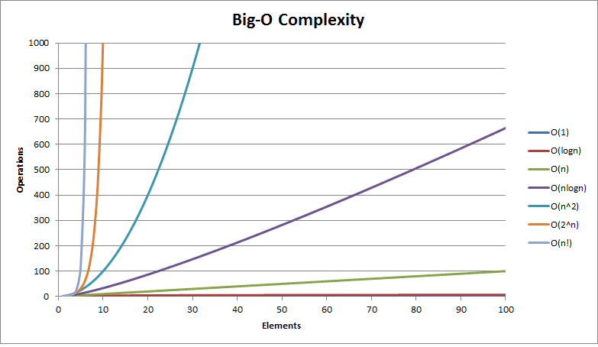

Slide 8
Why does growth rate matter?
Big-O | Problem size of 10 | Problem size of 100
O(1) | 1 | 1
O(log n) | 3 | 7
O(n) | 10 | 100
O(n log n) | 30 | 700
O(n^2) | 100 | 10000
O(2^n) | 1024 | 2^100
O(n!) | 3628800 | 100!

Slide 9
Two algorithms for searching for a value in an array
Linear search
Binary search
requires that items are sorted
Can be written using a loop or using recursion

Slide 10
What is the big-O of the linear search algorithm?
Size of the problem is number of items in the array to be searched
algorithm
For each element
If this element is the one being searched for
Return true
Return false
How many times does the loop execute?

Slide 11
Big-o of linear search algorithm
Best case
Does 1 comparison –> O(1)
Worst case
Does n comparisons –> O(N)
Average case
Does n/2 comparisons –> O(n)
Big-O of linear search algorithm is N

Slide 12
What is the big-O of the binary search algorithm?
Size of the problem is number of items in the array to be searched
Algorithm
While the array left to be searched is not empty
If the element in the middle is the one being searched for
Return true
If the element being searched for is smaller than the middle element
Search the lower half
Else
Search the upper half
Return false
How many times does the loop execute?

Slide 13
Big-o of binary search algorithm
Best case
Does 1 comparison –> O(1)
Worst case
Does (log₂ n) comparisons –> O(log₂ n)
Average case
Does (log₂ n)-1 comparisons –> O(log₂ n)
Big O of binary search
algorithm is (LOG₂ N)

Slide 14
Summary of big-O
Measures an algorithm’s growth rate
How time needed will increase as size of problem increases
Is independent of a particular machine or programming language
Is based on the number of instructions executed
Is meaningful when problem size is large
Some algorithms have a worst case big-o that is different than its average case big-O
Will see when we study sorting algorithms

Slide 15
What if the items to be searched were stored in a linked list?

Slide 16
Another use of big-o
Compare implementations of an abstract class
Efficiency of the methods
Memory space needed
Example – List is an abstract class
Can be implemented using
Fixed size array
Linked list
C++ vector<T>

Slide 17
Comparing list implementations
Operation | ArrayList | VectorList | LinkedList
append
insert
remove
retrieve
isEmpty
length
memory use

Slide 18
Comparing list implementations
Operation | ArrayList | VectorList | LinkedList
append | O(1) | O(1) | O(1)
insert | O(n) | O(n) | O(n)
remove | O(n) | O(n) | O(n)
retrieve | O(1) | O(1) | O(n)
isEmpty | O(1) | O(1) | O(1)
length | O(1) | O(1) | O(1)
memory use | O(capacity)* | O(capacity)** | O(n)
*capacity is fixed at compile time
**capacity changes as needed at run time

Slide 19
A loop to display contents of a list (written by user of a list)
for (int i = 1; i <= mylist.getLength(); i++)
{
cout << mylist.retrieve(i) << endl;
}

Slide 20
What is the big O of this loop
For an arrayList?
For a vectorList?
For a linkedlist?

Slide 21
What is the big O of this loop
For an arrayList?
O(n)
For a vectorList?
O(n)
For a linkedlist?
O(n²)

Slide 22
Adding iterator methods to the list class
Idea is that as long as the list is not empty the element at one of the positions is the current element
If the list is empty there is no current element
Add a data member to keep track of the position of the current element
For array and vector implementations the data member will be an int (index)
For linked implementation the data member will be a node pointer
Add 4 methods
Void move_To_start();
Sets current position to the first element in the list
Void next();
Sets current position to the next element in the list
Bool past_the_end();
Return true if current position is after the last element in the list; else returns false
ItemType get_current_Item();
Return element at the current position
Precondition: there is a current element

Slide 23
Rewrite this loop using iterator methods
void move_to_start();
Sets current position to the first element in the list
void next();
Sets current position to the next element in the list
bool past_the_end();
Return true if current position is after the last element in the list; else return false
ItemType get_current_Item();
Return element at the current position
Precondition: there is a current element
for (int i = 1; i <= mylist.getLength(); i++)
{
cout << mylist.retrieve(i) << endl;
}

Slide 24
for (int i = 1; i <= mylist.getLength(); i++)
{
cout << mylist.retrieve(i) << endl;
}
for( mylist.moveToStart(); ! mylist.pastTheEnd(); mylist.next())
{
cout << mylist.getCurrentItem() << endl;
}
mylist.moveToStart;
while ( ! mylist.pastTheEnd())
{
cout << mylist.getCurrentItem() << endl;
mylist.next();
}

Slide 25
Where should the iterator method prototypes be defined?

Slide 26
Where to define the iterator methods
Listinterface.h
All subclasses must define the iterator methods
Linkedlist.h
Iterator methods can only be used by objects of type linkedlist

Slide 27
Implement iterator methods for linkedlist class
Add data member
Node* current; (what does constructor initialize it to?)
Void linkedlist::movetostart(){ }
Void linkedlist::next(){ }
Bool linkedlist::past_the_end(){ }
Itemtypr linkedlist::get_current_item(){
}

Slide 28
Implement iterator methods for linkedlist class
Add data member
Node* current; (constructor: current = nullptr;)
Void linkedlist::movetostart(){ current = head; }
Void linkedlist::next(){ current = current->next; }
Bool linkedlist::past_the_end(){ return current == nullptr; }
Itemtype linkedlist::get_current_item(){ assert (current != nullptr); return current->data; }

Slide 29
Implement iterator methods for arraylist class
Add data member
int current; (what does constructor initialize it to?)
Void arraylist::movetostart(){ }
Void arraylist::next(){ }
Bool arraylist::past_the_end(){ }
Itemtype arraylist::get_current_item(){ }

Slide 30
Implement iterator methods for arraylist class
Add data member
int current; (constructor: current = 1)
Void arraylist::movetostart(){ current = 0; }
Void arraylist::next(){ current = current++; }
Bool arraylist::past_the_end(){ return current > size; }
Itemtype arraylist::get_current_item(){ assert ( Current < size ); return data[current]; }

Slide 31
Finding actual execution time
Can be used to compare performance on the same system
<ctime> has a function clock
Clock_t clock( );
Returns the processor time (expressed in clock ticks) consumed so far
Using the clock function
Clock_t ticks; ticks = clock(); // code to be timed ticks = clock() – ticks; // number of clock ticks to execute code being timed float seconds = (float)ticks / clocks_per_sec

Slide 32
Zybook assignment before class on Tuesday feb.20 ch.12 sec. 8 to 10 ch.15 sec. 1 t0 4

Slide 33
Stacks and queues

Slide 34
Quiz 2
After performing the following operations on an initially empty stack of characters: push (a) push (x) Push (D) push (Z) pop () what will be returned by peek()?
After performing the following operations on an initially empty queue of characters: push (a) push (x) Push (D) push (z) pop () what will be returned by peek()?
A queue has first-in last-out behavior (true or false)

Slide 35
Quiz 2
After performing the following operations on an initially empty stack of characters: push (a) push (x) Push (D) push (Z) pop () what will be returned by peek()? D
After performing the following operations on an initially empty queue of characters: push (a) push (x) Push (D) push (z) pop () what will be returned by peek()? x
A queue has first-in last-out behavior (true or false)

Slide 36
Two linear position oriented adts
Operation | Description
Push(stack, x) | Inserts x on top of stack
Pop(stack) | Returns and removes item at top of stack
Peek(stack) | Returns but does not remove item at top of stack
IsEmpty(stack) | Returns true if stack has no items
GetLength(stack) | Returns the number of items in the stack
Stack
Operation | Description
Push(queue, x) | Inserts x at end of the queue
Pop(queue) | Returns and removes item at front of queue
Peek(queue) | Returns but does not remove item at the front of the queue
IsEmpty(queue) | Returns true if queue has no items
GetLength(queue) | Returns the number of items in the queue
Queue

Slide 37
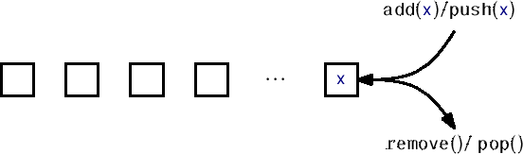
The stack adt
All operations occur at one end of the sequence (the top)
Has LIFO (last in, first out) behavior

Slide 38

The queue adt
operations occur at both ends of the sequence (add at front, remove from rear)
Has FIFO (first in, first out) behavior

Slide 39
Implementation data structures?
Same as for list
Fixed length array
Linked list
Vector<t>

Slide 40
What data members are needed?
for arraystack?
for linkedstack?
for arrayqueue?
for linkedqueue?

Slide 41
What data members are needed?
for arraystack?
itemtype[capacity] array
Size (or top)
for linkedstack?
Head (or top)
size
for arrayqueue?
Front
Rear
size
for linkedqueue?
Head (or front)
Tail (or rear)
size

Slide 42
What is the big-O?
Operation | ArrayStack |  | LinkedStack
push
pop
peek
isEmpty
length

Slide 43
What is the big-O?
Operation | ArrayStack |  | LinkedStack
push | O(1) |  | O(1)
pop | O(1) |  | O(1)
peek | O(1) |  | O(1)
isEmpty | O(1) |  | O(1)
length | O(1) |  | O(1)

Slide 44
What is the big-O?
Operation | ArrayQueue |  | LinkedQueue
push
pop
peek
isEmpty
length

Slide 45
What is the big-O?
Operation | ArrayQueue |  | LinkedQueue
push | O(1) |  | O(1)
pop | O(1) |  | O(1)
peek | O(1) |  | O(1)
isEmpty | O(1) |  | O(1)
length | O(1) |  | O(1)

Slide 46
Comparing use of memory
Arraystack?
linkedstack?
Vectorstack?

Slide 47
Comparing use of memory
Arraystack
O(capacity)
Capacity may be too small or too large for a given application
Linkedstack
O(n)
Each node needs space for an element and a pointer
Vector stack
O(capacity)
Capacity increases if needed so won’t run out of space
Capacity may be more than is needed for n elements

Slide 48
Expression evaluation
Arithmetic expressions are written using infix notation
each operator appears between its operands
order in which operators are used depends on
precedence rules (* and / have higher precedence than + and -)
parenthesis
in what order are the operators used:
3 + 2 * 5
(3 + 2) * 5
most compilers convert an infix expression to postfix and then evaluate the postfix expression
each operator appears after its operands
postfix expressions have no parentheses
3 2 5 * +
3 2 + 5 *

Slide 49
Evaluating a postfix expression
Expressions are made up of a sequence of tokens
Tokens are either operators or operands
Evaluation is done one token at a time
Operands have to wait for their operator
Push them on to a stack
When an operator is reached its operands are waiting on the stack
Get the operands from the stack
Apply the operator
Push the result (an operand) onto the stack
After all tokens are processed the result should be the only element on the stack

